Slide 1

Automotive Technology: A Systems Approach, 8e
Chapter 37: Clutches
Rob Thompson and Jack Erjavec, Automotive Technology: A Systems Approach, 8th Edition. © 2025 Cengage. All Rights Reserved. May not be scanned, copied or duplicated, or posted to a publicly accessible website, in whole or in part.

Slide 2
Chapter Objectives
37.01 Describe the various clutch components and their functions.
37.02 Name the different types of clutch linkages.
37.03 Explain how to perform basic clutch maintenance.
37.04 Name the most common problems that occur with clutches.
37.05 Explain the basics of servicing a clutch assembly.

Slide 3
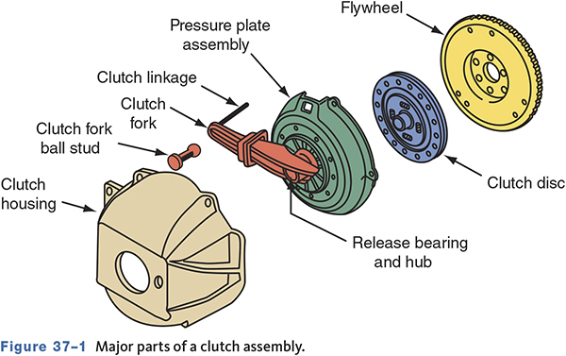
Clutch Components
37.01 Describe the various clutch components and their functions.
Notes:
3

Slide 4
Clutch Operation
The pressure plate is a large spring-loaded plate that engages the clutch by pressing the disc against the flywheel.
The pressure plate moves away from the flywheel when the clutch pedal is depressed.
The clutch release bearing is operated by the clutch linkage.
When the clutch pedal is depressed, the bearing moves toward the flywheel, depressing the pressure plate fingers and moving the pressure plate away from the clutch disc.
Notes:
4

Slide 5
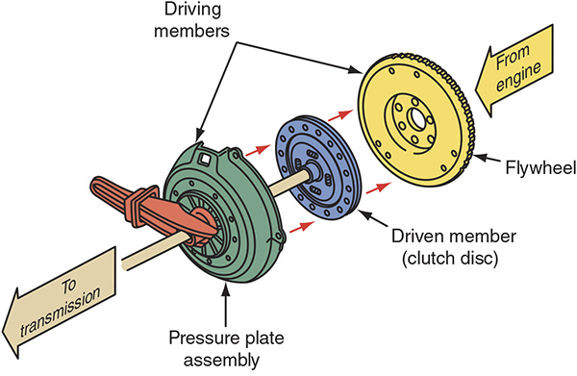
Clutch Operation
Notes:
5

Slide 6
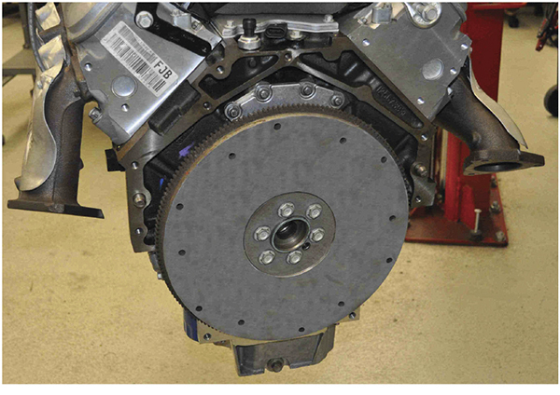
Flywheel
          Acts as balancer for the engine
          Adds inertia to the rotating crankshaft
          Provides a surface for the clutch to contact
Notes:
6

Slide 7
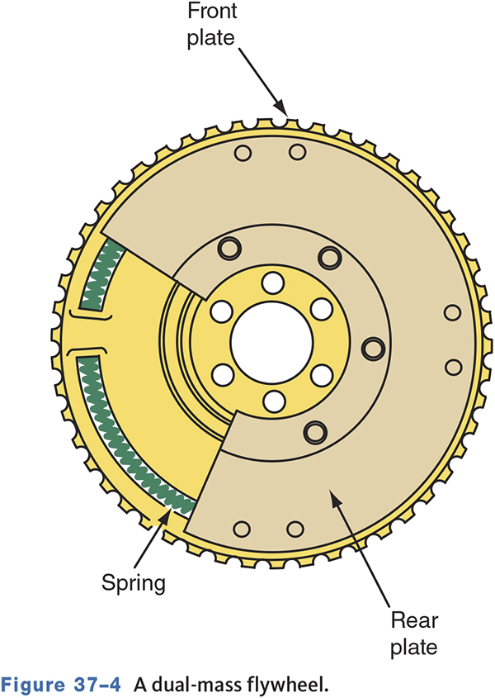
Dual Mass Flywheel
Used to reduce vibrations, provide for smoother shifting, and reduce gear noise
Notes:
7

Slide 8
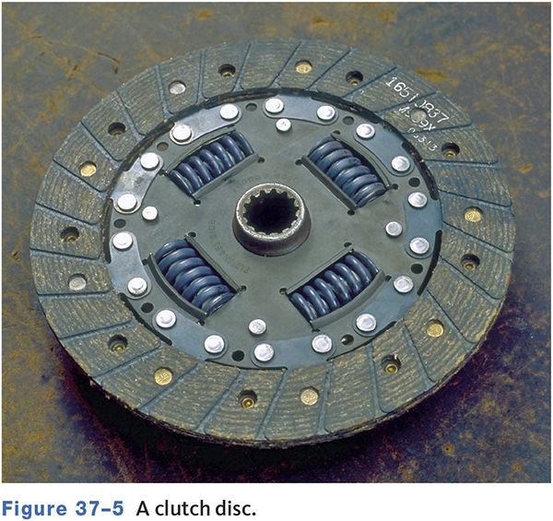
Clutch Disc
Is covered with friction material
Is squeezed between the flywheel and the pressure plate
Transmits power from engine crankshaft to transmission input shaft
Notes:
8

Slide 9
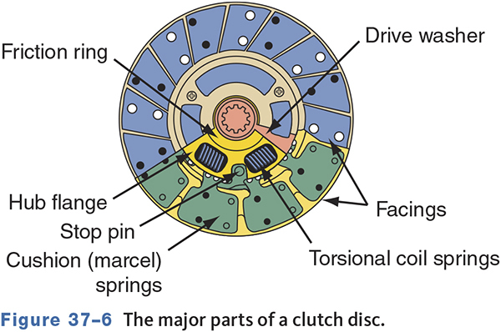
Parts of a Clutch Disc
Notes:
9

Slide 10
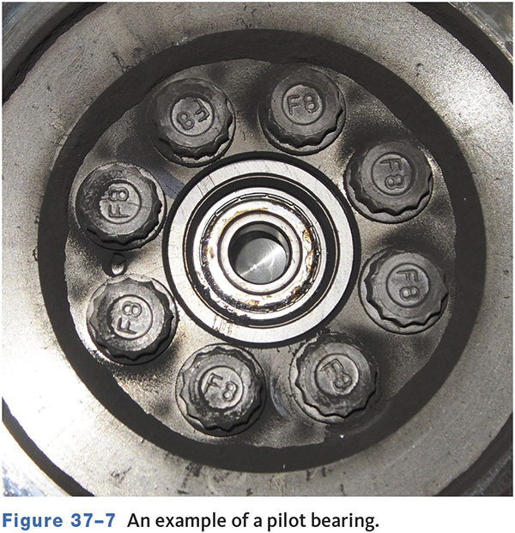
Pilot Bushing/Bearing
Supports the outer end of the input shaft
Inside end of the input shaft is supported by a bearing in the transmission.
Since the outer end is unsupported by the transmission, the pilot bushing/bearing supports and keeps the shaft aligned.
Notes:
10

Slide 11
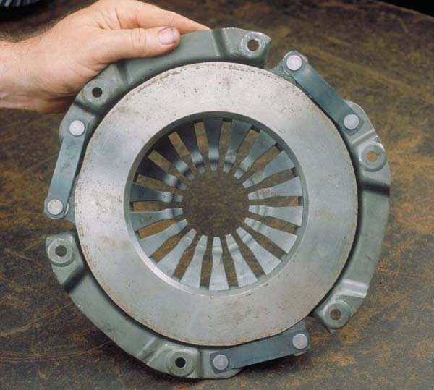
Pressure Plate Assembly
Squeezes clutch disc onto flywheel
Can be engaged or disengaged
Acts like a spring-loaded clamp
Notes:
11

Slide 12
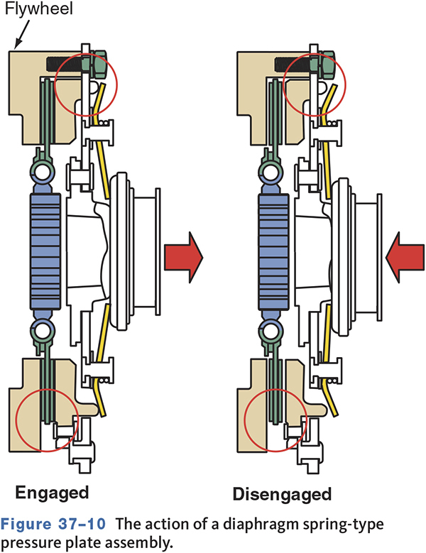
Pressure Plate Operation
Notes:
12

Slide 13
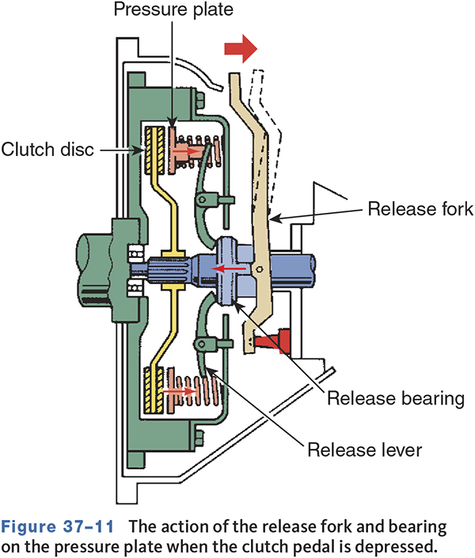
Release Bearing
Is operated by the clutch linkage
Presses against the pressure plate to release the clutch
Notes:
13

Slide 14
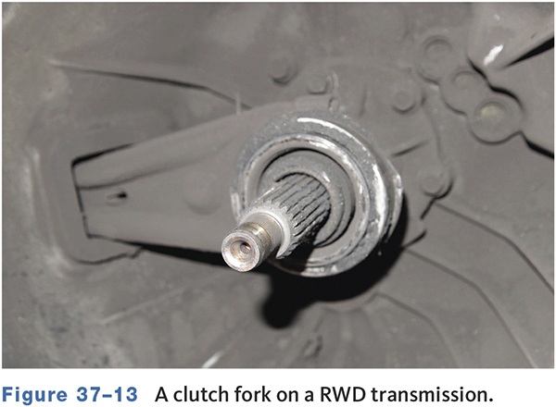
Clutch Fork
Moves the release bearing back and forth during engagement and disengagement
Notes:
14

Slide 15
Clutch Linkage
37.02 Name the different types of clutch linkages.
Clutch linkage transfers the clutch pedal movement to the release bearing.
Mechanical clutch linkage uses shafts, levers, or a cable.
Hydraulic clutch linkage consists of a master cylinder, hydraulic tubing, and a slave cylinder.
Notes:
15

Slide 16
Knowledge Check (1 of 2)
What are the four main components of a clutch?
Notes:
16
16

Slide 17
Knowledge Check Answer (1 of 2)
What are the four main components of a clutch?
Answer: Pressure plate, clutch disc, flywheel, and release bearing.
Notes:
17
17

Slide 18
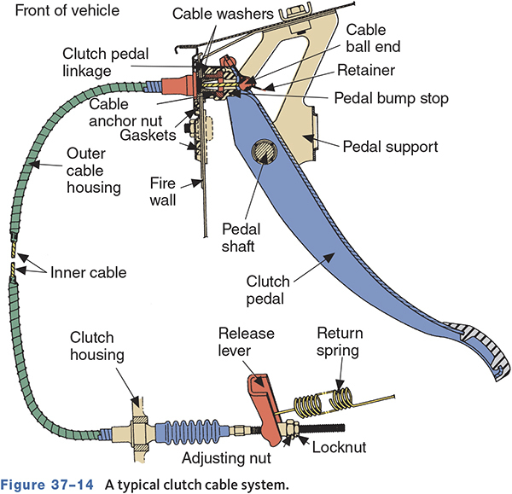
Mechanical Linkage
Notes:
18

Slide 19
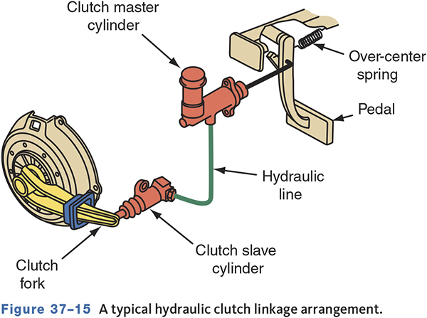
Hydraulic Clutch
Notes:
19

Slide 20
Service Precautions (1 of 2)
Always wear eye protection.
Use the proper equipment to remove asbestos particles and dust.
Never use compressed air to clean clutch dust.
Dispose of materials containing asbestos properly.
Notes:
20

Slide 21
Service Precautions (2 of 2)
Always work in a well-ventilated area.
Have a helper assist in removing a transmission.
Place the gearshift in neutral and set the parking brake when running a stationary vehicle.
Notes:
21

Slide 22
Clutch Fluid Level
Typically a small master cylinder set near brake master cylinder.
May share brake fluid reservoir.
Low fluid indicates a leak.
Normally, the desired level is ¼ to ½ inch (6 to 9 mm) from the top.
Notes:
22

Slide 23
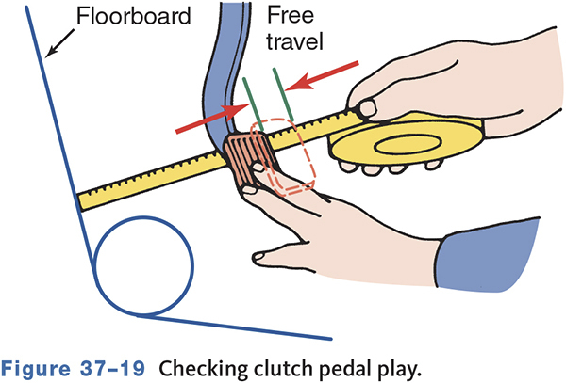
Clutch Linkage Adjustment
Linkage Adjustment
  Clutch pedal free play
Notes:
23

Slide 24
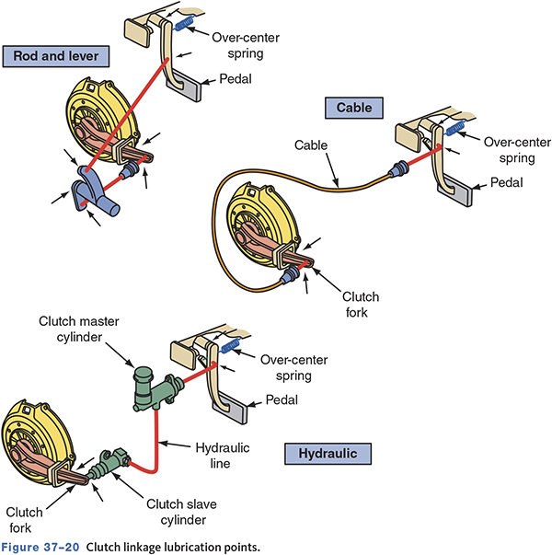
Clutch Maintenance
37-03 Explain how to perform basic clutch maintenance.
External Linkage Lubrication
  Lubricated during normal chassis lubrication.
  Lube sliding surfaces and pivot points.
  On hydraulic systems, check fluid level.
Notes:
24

Slide 25
Common Clutch Problems
37-04 Name the most common problems that occur with clutches.
Clutch Slippage—With the clutch engaged, engine speed increases but vehicle speed does not
  Check with parking brake set, engine at 2000 rpm, transmission in third gear
  Release clutch—engine should stall immediately
Before disassembly
  Check linkage
  Check for worn or binding parts
  Check engine mounts
Notes:
25

Slide 26
Other Causes for Clutch Slippage
Oil-soaked or worn disc facings
Warped flywheel or pressure plate
Weak pressure plate springs
Contact between the release bearing and the fingers of the pressure plate
Notes:
26

Slide 27
Drag and Binding
Dragging Clutch
  Is usually caused by linkage problems, incorrect pedal adjustments, warped disc or pressure plate, a binding or seized pilot bushing/bearing, or defective clutch assembly.
Binding Clutch
  Is usually caused by binding linkage or cables, damaged input shaft splines, or problems with the release levers.
Notes:
27

Slide 28
Clutch Chatter
Shaking or shuddering when clutch is engaged.
  Before Disassembly
    Check engine mounts.
    Check for leaks from rear main seal, transmission input shaft seal, and clutch slave cylinder.
Notes:
28

Slide 29
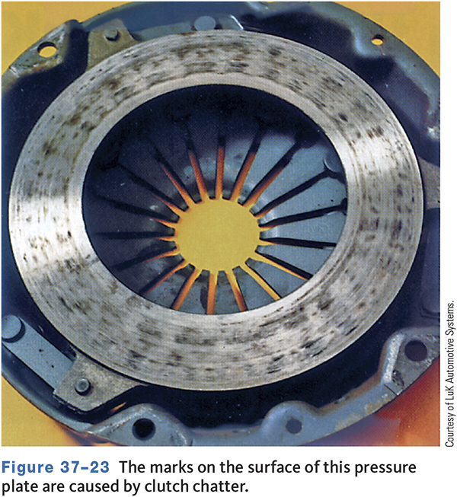
Chatter Wear
Notes:
29

Slide 30
Other Common Clutch Problems
Pulsating Clutch Pedal
  Is usually caused by broken or bent release levers, misaligned bell housing, or warped pressure plate, flywheel, or clutch disc.
Clutch Vibrations
  Are usually caused by worn engine mounts, loose bolts, excessive flywheel runout, or flywheel and/or pressure plate assembly imbalance.
Notes:
30

Slide 31
Clutch Noises
These noises are usually caused by bad bearings or bushings.
To diagnose, determine whether the noise changes with the clutch engaged or disengaged.
Notes:
31

Slide 32
Knowledge Check (2 of 2)
A vehicle has a slipping clutch.
Technician A says there may be oil leaking onto the clutch assembly.
Technician B says the pressure plate may be weak.
Who is correct?
Notes:
32
32

Slide 33
Knowledge Check Answer (2 of 2)
A vehicle has a slipping clutch.
Technician A says there may be oil leaking onto the clutch assembly.
Technician B says the pressure plate may be weak.
Who is correct?
Answer: Both technicians A and B
Notes:
33
33

Slide 34
Hydraulic-Operated Clutch Diagnosis
Soft clutch pedal or excessive pedal travel
  Is usually caused by low fluid level.
  May be caused by a faulty master or slave cylinder.
Hard pedal
  Is commonly caused by binding linkage or swollen cups in the master or slave cylinder.
Notes:
34

Slide 35
Clutch Service (1 of 2)
37.05 Explain the basics of servicing a clutch assembly.
Check bell housing and all clutch parts for signs of oil leakage.
Ensure clean engine and bell housing mating surfaces.
Check for damaged or warped mounting surfaces.
Check dowels and dowel bores.
Notes:
35

Slide 36
Clutch Service (2 of 2)
Check flywheel runout.
Check flywheel’s ring gear teeth.
Use a clutch alignment tool during disassembly and reassembly.
Loosen and tighten pressure plate bolts according to the correct sequence.
Torque all fasteners to specifications.
Notes:
36

Slide 37
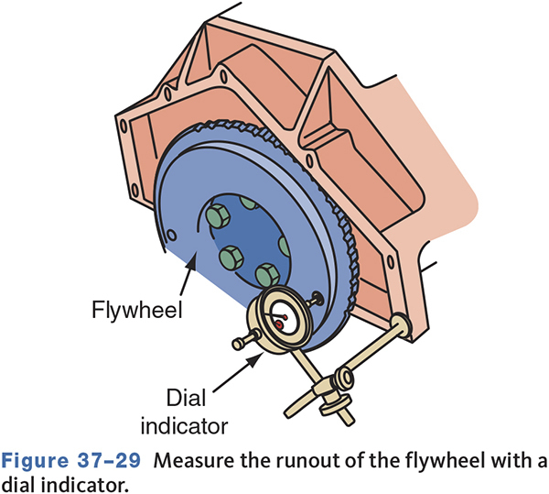
Checking Flywheel Runout
Notes:
37

Slide 38
Clutch Service
Keep grease and dirt off friction surfaces.
Check pressure plate warpage.
Check release levers for wear.
Inspect the release bearing.
Inspect/replace the pilot bushing or bearing.
Lubricate the input shaft and bearing retainer.
Check pedal free play after installation.
Notes:
38

Slide 39
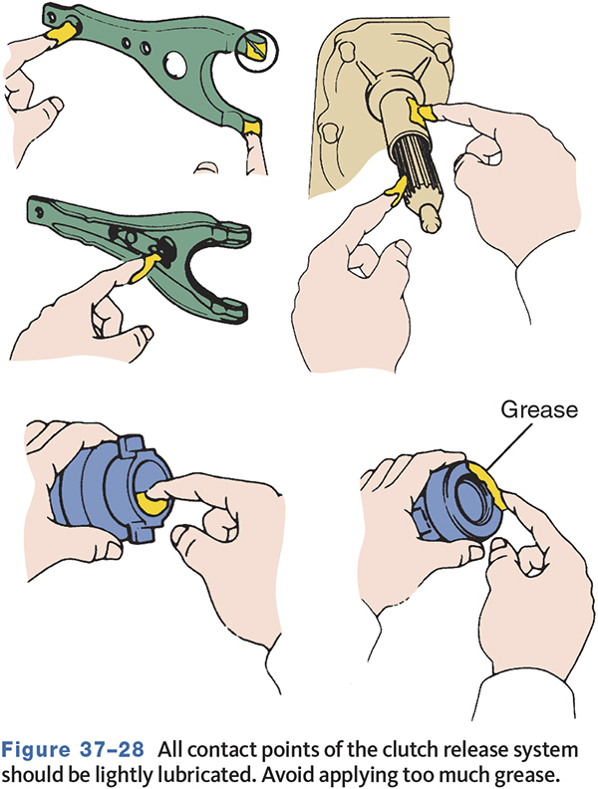
Lubrication Points
Notes:
39

Slide 40
Hydraulic-Operated Clutch Linkage Service
Check fluid level—do not overfill.
Inspect master cylinder and slave cylinder for signs of leakage.
Bleed the system if opened for component replacement.
Notes:
40

Slide 41
Clutch Bleeding
Whenever the hydraulic system is opened, the entire system should be bled.
Four different procedures can be used
  Power Bleeder
  Vacuum Bleeder
  Two person method
  Gravity bleeding
Notes:
41

Slide 42
Chapter Reflection
Write down the concept from this chapter that challenged you the most. Describe what made the concept difficult for you and the steps you took to improve your understanding.
How could you help another learner who was struggling with the same concept.
Use 100–150 words in your answer.

